Slide 1
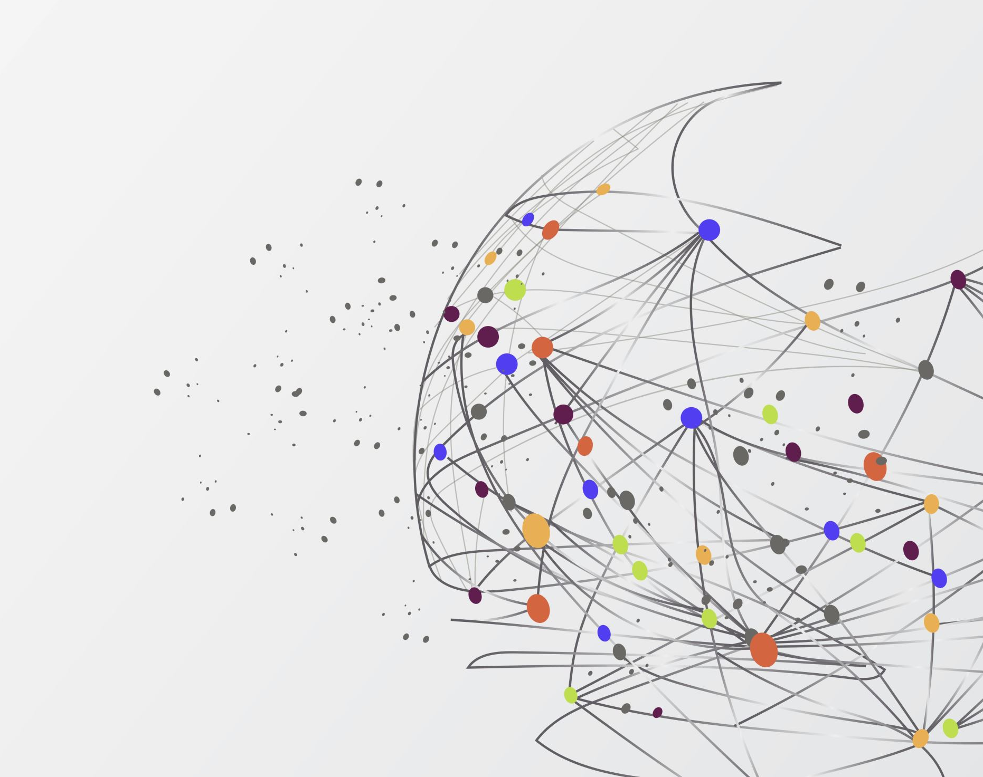
PHISHING DETECTION TOOL
How to protect us from Phishing URLs

Slide 2
Introduction:
in the beginning , We came up with the idea of the project because of the many scams that occurred during the Corona virus pandemic, as it was all online.
Exploiting the names of big companies, banks, social media platforms, or well-known organizations

Slide 3
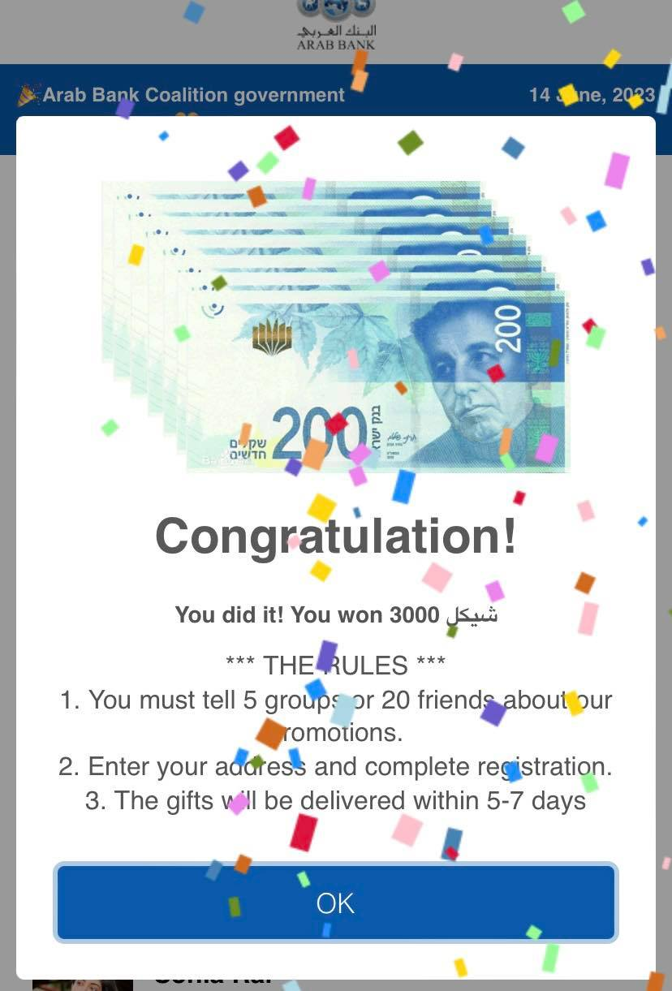
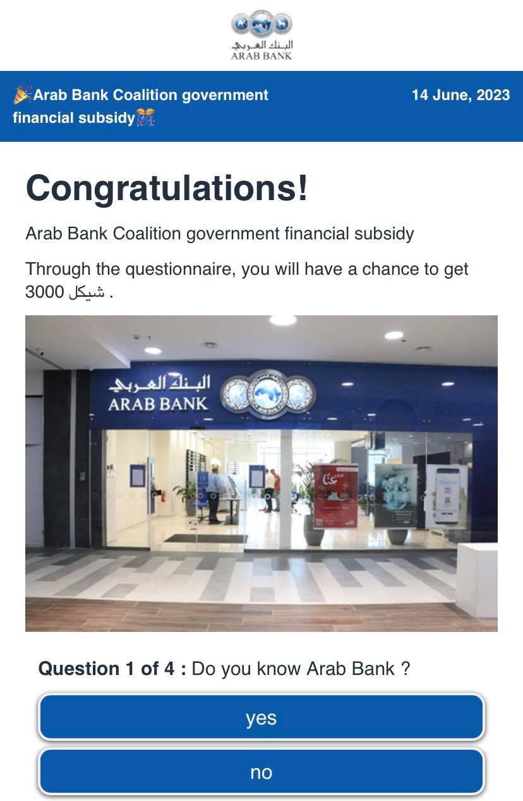
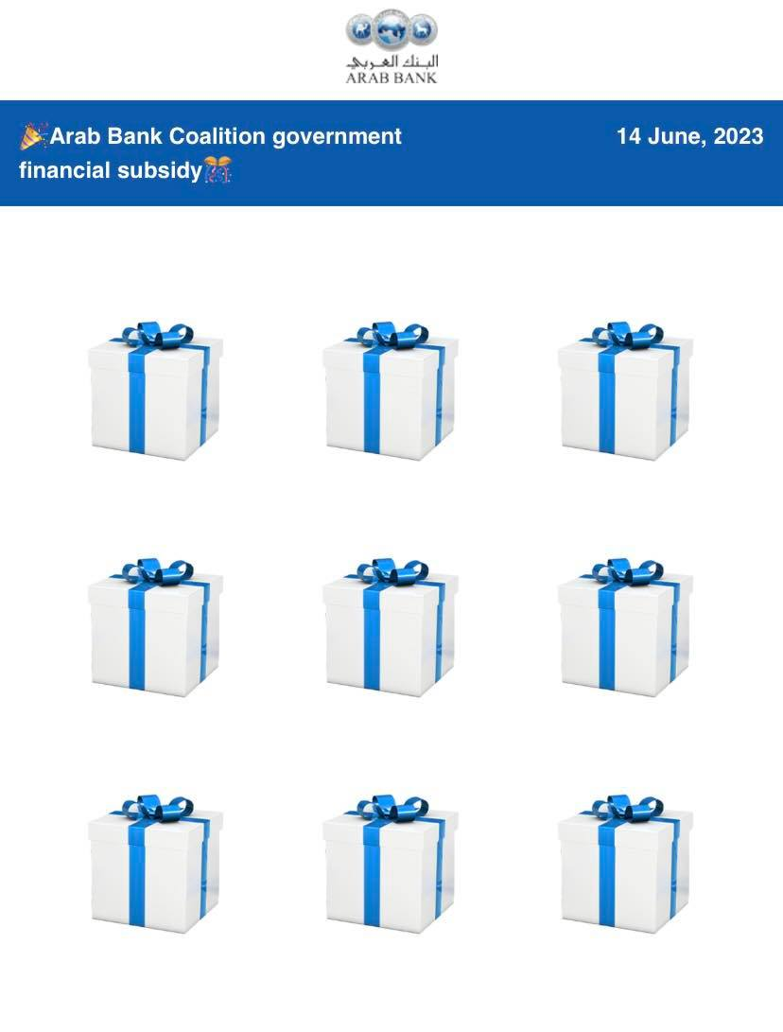

Slide 4

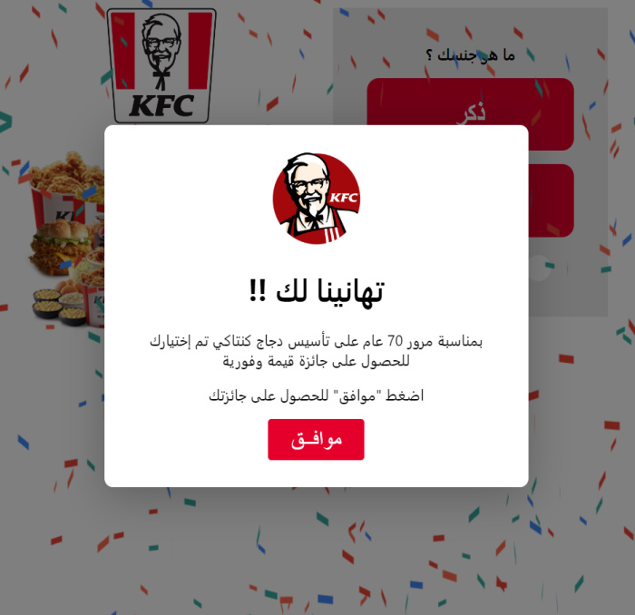

Slide 5
Basic Algorithms:
Naïve Bayes
Decision Tree

Slide 6
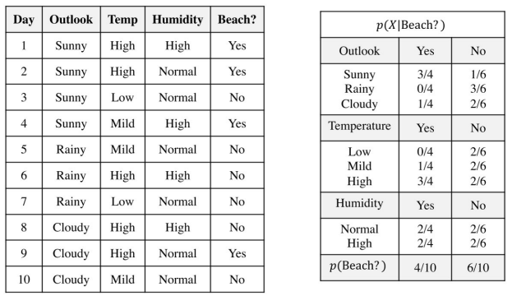
Naïve Bayes:
Naïve Bayes models are a group of extremely fast and simple classification algorithms that are often suitable for very high-dimensional datasets. Because they are so fast and have so few tunable parameters.

Slide 7
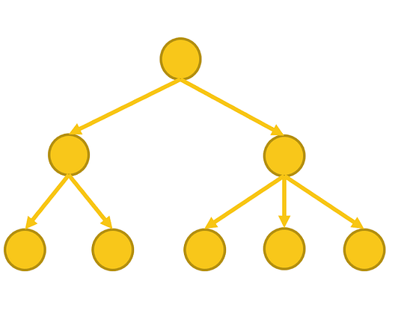
Decision Tree:
Recercivly splitting data ,choose best attribute each step , using entropy , aiming , create tree accurate predictions
 | color | height | Weight | Animal?
1 | brown | 60cm | 40kg | dog
2 | black | 75cm | 55kg | dog
3 | brown | 1800cm | 450kg | camel
4 | brown | 2000cm | 520kg | camel

Slide 8
Deep Dive:
NLP(natural language processing)
What is NLP?
NLP is a branch of AI that focuses on enabling computers to understand and interact with human language.
Techniques in NLP
TF-IDF Scoring : is a numerical representation that measures the importance of a term in a document within a collection of documents, considering both its frequency in the document and its rarity across the collection.
Uses in Search Engines

Slide 9
Examples
Phishing URL
http://www.google.xyz.cv
Trusted URL (Not Phishing)
https://www.youtube.com

Slide 10
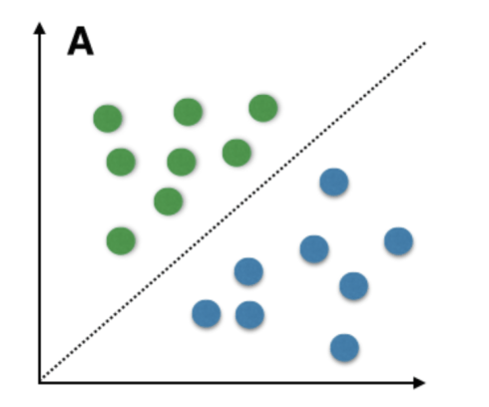
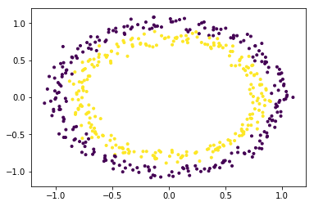
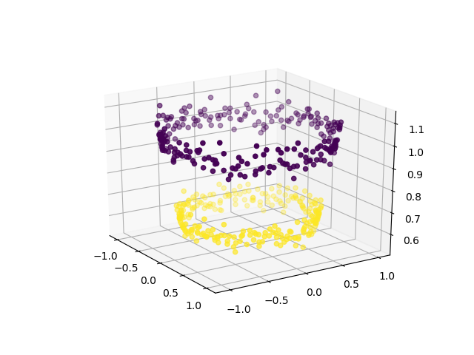
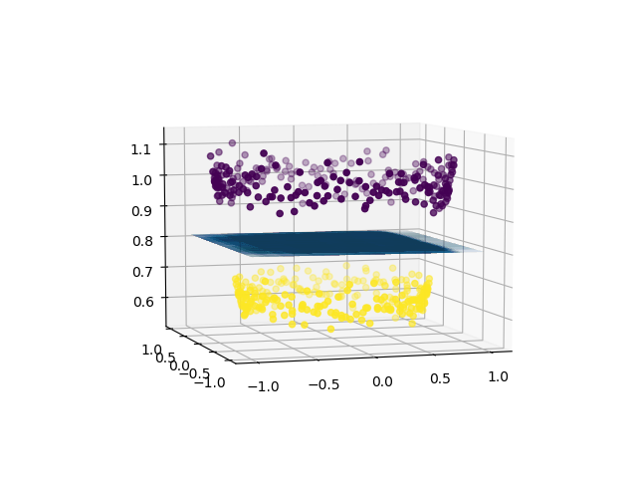
Linear SVM:
machine learning algorithm that finds the best linear decision boundary to separate different classes of data points.

Slide 11
Exercise:
Classify this phishing or not : http://www.facbook.com
Code:
Phishing URL Detection | Kaggle

Slide 12
Places of use:
Normal Internet Users.(Security, Time and Cost Savings.)
Official Platforms (integrity, financial loss, unauthorized access)
Can combined in another websites .

Slide 13


Comparison:
VS
Goodbye Phishers
Messenger

Slide 14
Tested URLs
بطاقات شحن مجانا - فلسطين (palscards-1.pages.dev)
H-KF (home-fyp.pages.dev)

Slide 15
Advantages:
Enhanced Security (98 % Accuracy )
proactive protection (early detection )
website
Accessibility, Wide Reach .
Easy Updates, Maintenance and Support .

Slide 16
View the website:
Links here :
https://bit.ly/AC_GP_2023
User Education (Tips)

